Slide 1















Getting ready for the challenges of the new digital world
Lessons learned and new opportunities unveiled by
S/4 HANA
Stavanger, March 2017

Slide 2


SAP S/4 HANA
Our vision…

Slide 3





We at an inflection point, and why do we view this as a
digital revolution?
USE OF TECHNOLOGY
The usage of technologies is now widespread among society; technology and our behavior is converging for the first time
1
FUNCTIONALITY STEP-CHANGE
New technologies are maturing at the same time (mobile, social media, digital devices, network reach etc.) resulting in a step-change in functionality
2
FUTURE GROWTH
Many enterprises have reached an impasse in their current business models and are looking to the new
technologies to drive future growth and profitability
3
PUBLIC SECTOR AND GOVERNMENT
Governments are ‘should bett on digital’ as the key catalyst to modernizing public services, saving costs and transforming relationships with citizens
4
A DIGITAL REVOLUTION ENABLED
Digital Transformation is the use of technologies to improve radically
the performance or reach of enterprises
BY DIGITAL Transformation
3

Slide 4
Digital transformation impacts value chain of every industry
creating new business opportunities
move up
Value chain 1 | Raw Materials | Components | OEM | Retailer | Consumer
Inbound logistics
Operations
Outbound logistics
Sales
Services
integrate
New Digital Ecosystem
Value chain N | Raw Materials | Components | OEM | Retailer | Consumer
Inbound logistics
Operations
Outbound logistics
Sales
Services
3

Slide 5



SAP is adapting itself to the new order and
S/4 HANA is the core of it’s strategy.
HCM - Human Capital Recruiting - Performance management - Training
On-premise or SaaS flavors
Core Enterprise: Finance & Controlling – Manufacturing – Asset Management (including software management) – Industry specific solutions
Vendor Management Manage and procure staffing services
HANA Cloud Integration Cloud-based Integration platform
SCM - Supply Chain Sales & Operations Demand inventory
Response & Supply planning
CRM - Customers engagement Front Office Customer insights
SRM: Full PO management – Supplier management with tight integration to logistics and production planning – Embedded catalog
IoT
Device management Shadow device data Events management
SRM - Suppliers relationship
Strategic Sourcing Catalog Management
CRM: Order execution – Post-sales service – Core transactions – Universal customer
SCM: Production planning – scheduling – available to promise – Transportation management – warehouse management
HCM: Payroll – Benefits & core transactions – Universal employee
3

Slide 6



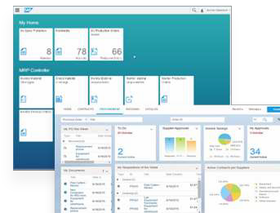




…that requires multi-disciplinary skills
Increased business productivity
•Real time, no batch jobs
•Manage by exception concept
•Transparent Integration between Planned & Actuals
Simplified business processes
•Role based Fiori Apps
•Less steps to execute actions
Native integration with Business
Networks
•Integrated to Success Factors, Ariba, Hybris, etc.
Simplified technology
•Simplified data model
•No data redundancy
•Mobile ready
3

Slide 7
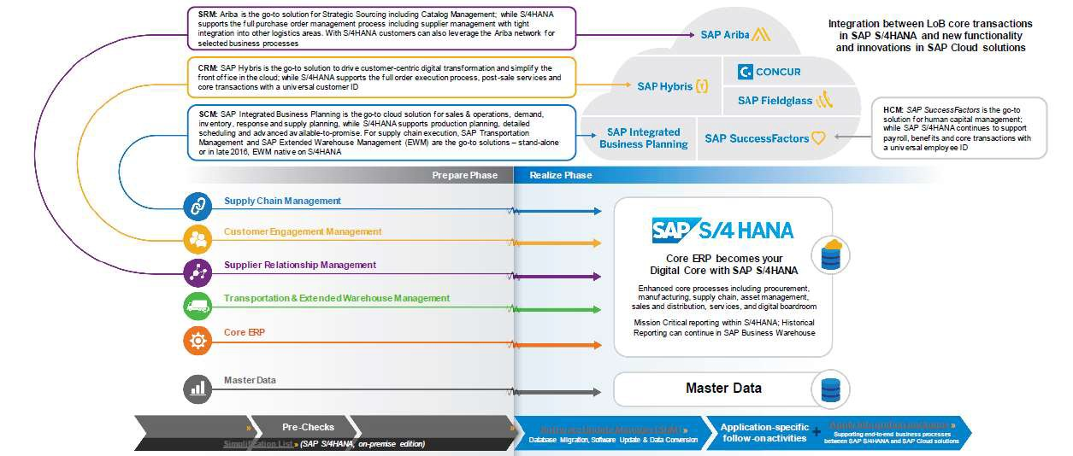
ECC Landscape and Evolution according to SAP
SAP LABS PREVIEW
Source: Christian Vogler, Outbound Product Management SAP S/4HANA, SAP SE –Germany July 2016
3

Slide 8
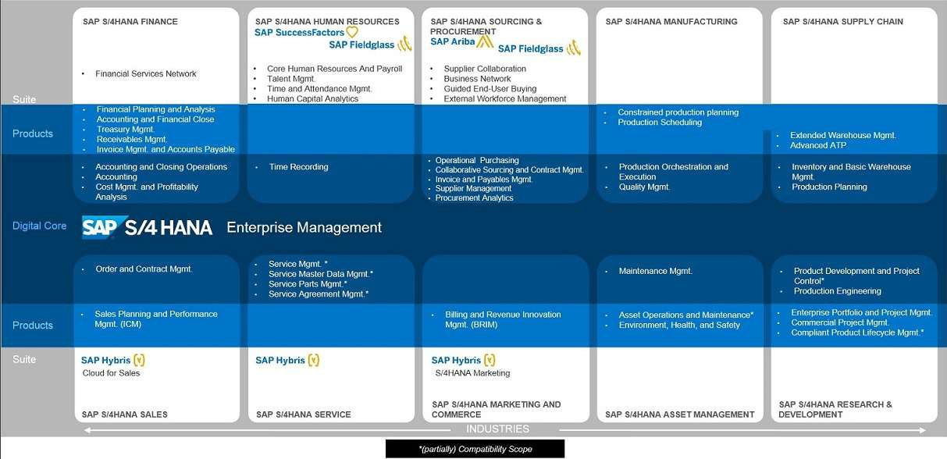

What is included in SAP S/4HANA, Enterprise Management
Detailed business scope of the 1610 release
3

Slide 9
All key innovations will be developed for S/4 HANA platform
Higher potential for innovation
Limited to transactional
Higher legacy compatibility
Fiori
Fiori
S/4 HANA
SAP HANA
Limited code
push-down
Any DB
SAP ECC 6
Simplified
Model
Extra code for managing data consistency
Legacy model
Innovation is transported only if possible
S/4 HANA is the new SAP corporate platform, and SAP ECC will be supported only till 2025
SAP priority is to leverage SAP HANA, S/4 simplified data models, and Fiori for developing innovation.
SAP Innovation will be transported to ECC when possible…
3

Slide 10
Now that with S/4 HANA is free to evolve they are working hard to improve its new ERP platform
We observe a growth in 46% in the number of changes between the last two releases
Logistics - PP
En la SL de S/4 HANA v1610 has 437 changes
21% are changes in existing functionality
25% are replacements to existing functionality
37% are elements that are no longer there
53% of the impact affect PP, SD and MM-IM
SL v1511 had 299 entries, in th eversion 1610 we have 437. That represents a growth of 46% in 11 months
But real impact will depend on the real usage of the systems
Sales & Distribution
Financials - Controlling
Logistics - MM-IM
Financials - Miscellaneous
Logistics - PM
To know more look here: https://blogs.sap.com/2016/10/31/simplification-list-sap-s4hana-1610/
10

Slide 11
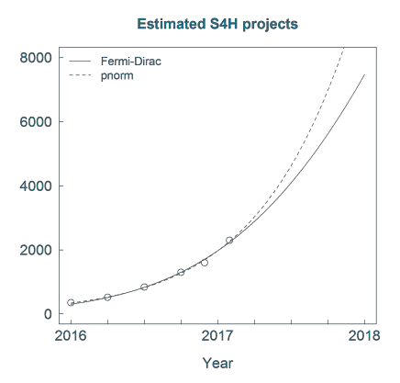

On the other hand S/4 HANA adoption is growing fast
SAP has be Jan 2017, 2300 S/4 HANA on-
going projects and 550 live customers
Only 30% are upgrades
Total number of S/4 projects is growing exponentially
Gartner expects a growth in investments in S/4 HANA projects of 2x till end of 2017
SAP expects S/4 HANA Public cloud to represent 14% of SAP ERP market by 2020
Careful we may have a new “SAP Bubble” ahead!
Factors that may slow-down adoption: growth of SaaS and BaaS, lack of certified resources
Disclaimer: the information presented above is based on predictive models, and should be taken only as indicative information.

Slide 12






All those elements will impact our conversion strategy
2
The overall cost for the conversion will depend on the amount of resources available and the cost for implementing the changes introduced in the platform
1
0
2016
2018
2020
2022
2024
5
4
3
2
1
0
2016
The total estimated cost in time will depend on the particular functional impact that the S/4 HANA changes will have in a given implementation…
Disclaimer: the information presented above is based on predictive models, and should be taken only as indicative information.
2018
2020
2022
2024

Slide 13









Capgemini and SAP do not recommend anymore migratings to Suite on HANA as an intermediate step to S/4 HANA
A two step conversion represents dedicating 25% to 37% of your time to conversion activities…
Business Suite
Suite on HANA
Suite on HANA
S/4 HANA
IBP &
Ariba
Conversion
project
New GL Upgrade (optional) project
2016 2020
Disclaimer: the information presented above should be taken only as indicative information.
2024
2025
End of ECC support

Slide 14









Capgemini and SAP do not recommend anymore migratings to Suite on HANA as an intermediate step to S/4 HANA
With a one-step migration we would dedicate only 12% to 15% of our time getting additional resources for innovation.
Business Suite
S/4 HANA
IBP &
Ariba
Conversion
project
New GL (optional)
New Apps
New Apps
New Apps
New Apps
New
Apps
2016 2020
Disclaimer: the information presented above should be taken only as indicative information.
2024
2025
End of ECC support

Slide 15

What brings S/4 HANA for business

Slide 16










Fiori impact on operations with S/4 HANA
Example: Inventory management
Inventory Manager Analyze Turnover | Analyze material stock
Warehouse Clerk | Post Goods Entries | Attach Document | Analyze plant inventory | Transfer & Scrapping | Analyze Postings
https://www.youtube.com/watch?v=RsmjNWL9LMc
SAP GUI | SAP Fiori UX
Duration 8:10 mins | Duration: 2:58 mins
Clicks: 135 | Clicks: 64
Number of Apps: 10 | Number of Apps: 7
Fields filled: 18 | Fields filled: 8

Slide 17
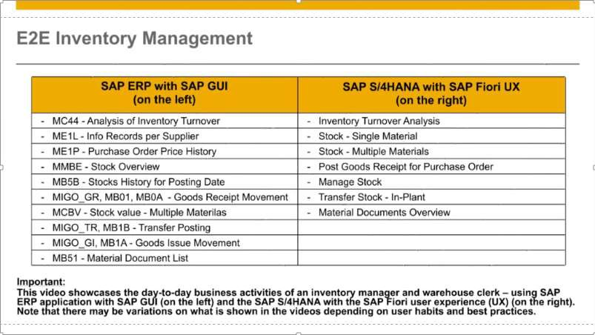
Fiori impact on operations with S/4 HANA
Example: Inventory management (source SAP: https://www.youtube.com/watch?v=RsmjNWL9LMc)

Slide 18











SAP S/4HANA 1610
Key Innovations mapped to the SAP S/4HANA value levers
Consistent SAP Fiori UX
Harmonized User Experience
Automation
System of Intelligence Agility (Integration / HCP) Business Network
Industry to Core (DIMP, Oil, Retail)
Extend Core Functionalities
Automation
System of Intelligence Agility (Integration / HCP)
Business Network
SAP S/4HANA Finance in Core
Integrate Financial Operations for Compliance
Automation
System of Intelligence Agility (Integration / HCP)
Business Network
Optimized Portfolio & Project Mgmt.
Management of Strategic Initiatives
Automation
System of Intelligence Agility (Integration / HCP)
Business Network
Efficient Procurement
Shopping Experience
Automation
System of Intelligence Agility (Integration / HCP)
Business Network
Integrated Quality Management
Efficient Supply Chain
Automation
System of Intelligence Agility (Integration / HCP)
Business Network
Integrated Extended Warehouse Mgmt.
Warehouse Logistics Processes
Automation
System of Intelligence Agility (Integration / HCP)
Business Network
advanced available to promise
Product Strategy Allocation
Automation
System of Intelligence Agility (Integration / HCP)
Business Network
Effective Order Management & Billing
Streamline Order Processing
Automation
System of Intelligence Agility (Integration / HCP)
Business Network
Embedded Software in R&D
Lifecycle of Embedded Control System
Automation
System of Intelligence Agility (Integration / HCP) Business Network
Real Time Inventory Management
Physical Inventory Count
Automation
System of Intelligence Agility (Integration / HCP)
Business Network
Accelerated MRP
Production and Procurement Planning
Automation
System of Intelligence Agility (Integration / HCP)
Business Network
Legend
Automation: Robotic process automation of existing business processes
System of Intelligence: Self-learning system of intelligence based on data
Agility (Integration / HCP): Service consumption
Business Network: End-to-end collaboration (supplier and purchasing communities, IoT devices and business processes)
This is the current state of planning and may be changed by SAP at any time without notice

Slide 19
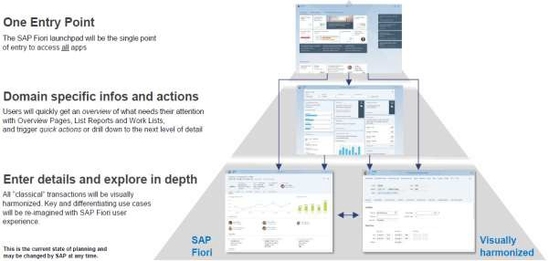
S/4HANA IS-Oil: partially released in version 1610
Full enablement of oil & gas
downstream functionalities
Redesigned hydrocarbon product management (HPM)
Unit-of-measure group enhancement solution based on simplified HPM data model
Inventory Planning Workbench (IPW) optimized on HANA as part of the SAP Trader's and Scheduler's Workbench application
Role in SAP Fiori for transportation schedulers with apps for regional dashboards, nominations, and events
New standard Fiori O&G roles: Supply Chain Manager, Inventory Manager, Shipping Specialist, Billing Clerk, Transportation Scheduler
Fiori 2.0 with unified look and feel
Source: Michael Lamade, SAP SE Global Head of S/4HANA Industry Program
November 2016
To know more on Fiori for Oil&Gas: https://fioriappslibrary.hana.ondemand.com/sap/fix/externalViewer/#

Slide 20


Lessons learned from running S/4 HANA projects

Slide 21











Selected on-going projects on HANA at Capgemini
25 are S/4 HANA
S/4 HANA
Migration
Real time analytics
S/4 HANA
New Install
HANA
technical
upgrade
S/4 & SoH projects
S/4 HANA
support
Vertical Industry solutions
Central Finance
Global Electric engeniering & Systems provider
Digital transformation
Global Fashion retailer

Slide 22
Key takeaways!
Did not moved to Suite on HANA! Maybe you should move to S/4 HANA
strait away
No need anymore to move to New GL beforehand. SAP is working to help you migrating after you move to S/4 HANA
Check for the impact in your running initiatives: S/4 HANA introduces functional changes into processes that you may be implementing now: i.e. TM, WM,…
Think holistic: S/4 HANA may impact your operational reporting and your strategy for Business planning and Consolidation. You may be missing great opportunities for rationalizing your infrastructure
Your users will love it! S/4 HANA is Fast, real-time, simple and easy to handle for the business… And it does what SAP claims…

Slide 23




FARYS business transformation over the years
Increasing Business and IT complexity
Business and IT complexity
Further business expansion
Introducing FARYS
Business expansion: Legal, Financial & Stakeholder Reporting
Insourcing customer services & billing
Migration on Suite on SAP HANA dashboarding, KPIs
Mobile analytics
S/4 HANA 1503
Lumira
….
PPM
BW7.3
BO4.x
BPC
Mobile (Workmanager)
NewGL
Migration
Stepping into the
21st century
ISU
SAP ERP
Coming to one flexible source of the truth
2002 2005 2010 2011/12 2015 →

Slide 24













Outcome of the project
The New Roadmap
Q1 2015
Q2 2015
Q3 2015
Q4 2015
Q1 2016
Q2 2016
Q3 2016
Q4 2016
Definition of new operation model of FARYS
Implementation of New operational model
wave 1
Implementation of New Operational model wave 2 including simple finance with embedded BPC
HANA upgrade BW & CRM
Mobile Workmanager
S4/HANA
migration
Implementation of New Operational model wave 3 including simple Finance Fiori apps
Implementation of logistical fiori apps
Simple Finance
1.0
Evaluation of
Simple Finance 2.0
Evaluation of Simple Logistics

Slide 25
How to move forward?
Discover
Prepare
Explore
Realize
Deploy
Run
S/4 HANA
Pilot
Evaluate industry best practices
Configure and
adapt
Migrate,
Integrate, Roll-out ^{Operate &}
_{Expand} Support
• Industrialized • Support end • Business system user training process
migration for platform operations
• Integrate the changes and
platform • Support administration
• Activate training for • Management
required process of continuous
system changes improvement
extensions • Premium and innovation
support
Deploy a S/4 HANA sandbox or Pilot
Validate with key users Standard SAP functionality by using best practices deployment
Detailed custom code analysis with emphasis on “replacement by standard” & custom code adaptation to S4H
Identify quick wins
Identify gaps and adapt the platform

Slide 26














































Typical Roadmap 2017 – 2020
Leyenda
Preparation activities
Technical activities
Functional activities
2017
2018
2019
2020
BW4 HANA
Upgrade (optional)
Migrate Planning solutions to BPC
Deployment of CFO Cockpit
Integration Planning +
Digital Platform
Understand SAP roadmap for BW4 HANA
Actuals
Deployment of Corporate mini Apps-Fiori
Analytics
Optimized for S/4
BPC Optimized for S/4 HANA
Integrate CDS Views to BI platform (s)
Process optimization
Analyze impact of SAP end-of support policy for Planning & Consolidation tools
Automation and IoT integration
Roll-out of Fiori Apps for S/4 HANA
Understand SAP strategy for Planning & Consolidation
S/4 HANA implementation Finance & Billing for
S/4 HANA
implementation Logistics & Asset Management
S/4 HANA
Pilot in cloud (optional)
Utilities
Evaluate impact on custom developments (z-code)
Understand S/4 HANA impact in Finance accounting & Billing
Understand real Business Case for S/4 HANA
Understand S/4 HANA impact in Logistics
Analyze impact of SAP end-of support policy for ECC components
Finance
ERP

Slide 27
Possible transition scenarios to S/4 HANA
_{New} New I_{I}m_{m}p_{p}l_{l}e_{e}m_{m}e_{e}n_{n}t_{t}a_{a}t_{t}i_{i}o_{o}n_{n}
ERP
Non SAP
S/4 HANA on-premise S/4 HANA cloud edition
Example:New or existing SAP customer implementing a new SAP S/4HANA system with initial data load
_{Syst}S_{e}y_{m}stem _{co}C_{n}o_{v}n_{e}v_{rs}e_{i}r_{o}s_{n}ion
Example: Complete conversion of an existing SAP Business Suite system to SAP S/4HANA
SAP ERP
S/4 HANA on-premise
_{La}L_{n}a_{d}n_{s}d_{c}s_{a}c_{p}a_{e}pe _{t}t_{r}r_{a}a_{n}n_{s}s_{f}f_{o}o_{r}r_{m}m_{a}a_{t}t_{i}i_{o}o_{n}n
SAP ERP system 1 SAP ERP system 2 SAP ERP system 3
S/4 HANA on-premise S/4 HANA cloud edition
Example: Consolidation of current regional SAP Business Suite landscape into one global SAP S/4HANA system
C^{C}eªn^{r}t^{v}r⁻aºl^{u}F^{t}inance
scenario
S/4 HANA on-premise
S/4 HANA cloud edition
Example: Existing Business Suite system whose FI module is installed in a dedicated instance to enforce a consolidated strategy for FI operations
SAP ERP
_{So}S_{l}o_{u}l_{t}u_{io}ti_{n}on_{re}r₋e-
design
SAP ERP SAP CRM SAP SCM SAP SRM
S/4 HANA on-premise S/4 HANA cloud edition Ariba, Hybris, IBP
Example: Existing SCM or SRM system whose functionality has been distributed between S/4 HANA and SaaS solutions
design

Slide 28
Appendix

Slide 29
Example of Business process
simplification

Slide 30
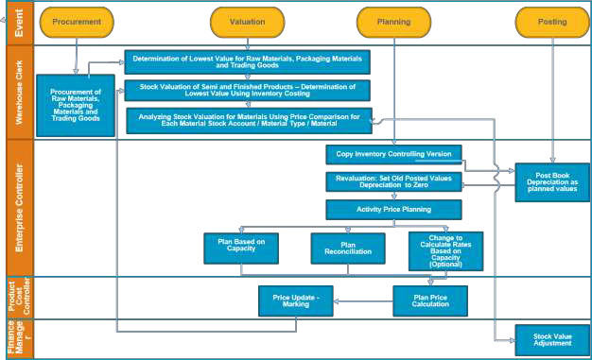
Inventory Valuation for Year End Closing
REQUIRED TRANSACTIONS:
MRN0: Deter. Lowest Value: Market Prices
KP98: Copy Actual to Plan for Cost Centers
S_ALR_87099918: Primary
Cost Planning Dep./Interest
KP90: Delete Planned Costs
KP26: Planned Actvity
KPSI: CO-CCA Plan Reconciliation
CK11N: Create Material Cost Estimate
CK24: Price Update with Cost Estimate
MRN9: Balance Sheet Values
by Account
FB50, FB50L: Journal entry
30

Slide 31
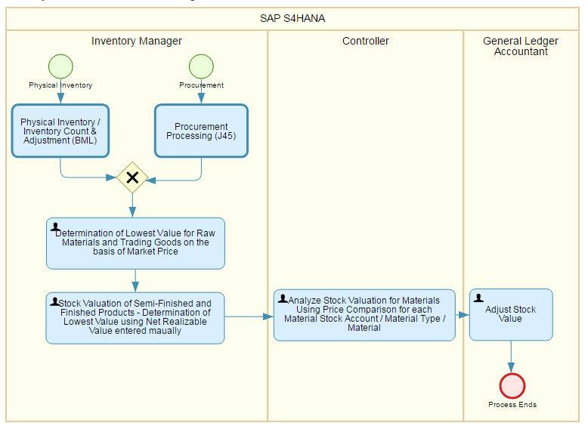
Inventory Valuation for Year End Closing
REQUIRED FIORI APPS:
Determine lower of cost or market value
Change Material
Balance Sheet Value by
Account
Post General Journal Entries

Slide 32
Why Capgemini?

Slide 33










Capgemini – A Global SAP Leader Since 1993
SAP Practice at Capgemini
More than 16,300 SAP resources globally
2,500 skilled resources in North America, 4,400 in EMEA, 8,000 in APAC and 1,400 in LATAM
30+ Delivery and Solution Design Centers around the globe
With more than 190,000 people in
over 40 countries, Capgemini is one of the world's foremost providers of consulting, technology, and outsourcing services.
SAP Global Services Partner
SAP Gold Partner – Reseller Program
Global SAP Services Partner
Global SAP Hosting Partner
Designing and delivering solutions that meet your
specific business and technology needs.
As a Global SAP Partner, drives results through licensing, implementation, infrastructure and application management in key industries across the globe. We focus on delivering business value through our SAP Delivery and Solution Design Centers using our Intellectual Property solutions for the Cloud, Mobility, Analytics, HANA; our OnePath pricing and licensing models; and preconfigured industry solutions across the entire lifecycle of services.

Slide 34








Capgemini’s Services
Implementation
Application
Infrastructure
Services
Broad capabilities within the SAP consulting services offering.
Management
Enhancing effectiveness and efficiency through the dedicated support of our clients’ end-to-end value chain.
Services
Infrastructure designed and implemented leveraging our COMPLETE Business Cloud platform which includes:
.
SAP Implementation Services including:
Process Redefinition
Application Management & Support:
SAP License Maintenance Support Levels
Infrastructure Management:
Sizing and Proactive Cloud Orchestration
Implementation and Integration
SAP Application and Technical Upgrades
Program management
Training/Change management
Full SAP MA and Divestiture transition projects
Pre-Implementation deployment/rollout Strategy
Existing SAP System optimizations
Financials, Sales, Supply Chain Management, and Human Resources
BW, SEM, CRM, APO, PLM, QM, and Portals
Enhanced Reporting/Executive management Reporting
1-3
100% Dedicated Support Team
Build-to-Run Approach
Monthly Functional and Basis Support
Operational dashboards
Root Cause Analysis (RCA)
Proactive preventative maintenance with trending analysis
SLA Reporting
Operating System Maintenance and Patching.
Infrastructure Monitoring, Metering and Reporting.
System Backups.
Network Administration & Security.
Incident Management, Change & Service Requests.
Full SAP Landscape Support.
Multiple Disaster Recovery Solution Options.
* COMPLETE (Capgemini Orchestration Management PLatform End to End)
We can grow with you!

Slide 35







Why Capgemini should be your partner on SAP S/4 HANA?
Expertise
More than 50 projects deployed in 21 countries based in SAP HANA technology. 22 S/4 HANA projects in most industry sectors like Utilities, Retail, Oil & gas, Chemistry…
1400 trained resources (150+ certified)
Global SAP HANA enablement programs in all key business areas like Finance and Logistics (in collaboration with SAP).
Highway to
Innovation
Since 2012 developing native SAP HANA applications for POS Analytics for Retail, Smart Meter Analytics for Utilities, Social Media with Geographic-based real-time feeds. CFO Cockpit RDS for Automotive. Anti-Terrorism Squad Solution
Pre-configured cloud deployments of S/4 HANA for Manufacturing and Consumer products, Oil & Gas and Life Sciences
Service Set-up
Industrialized SAP HANA migration services provided by the Accelerated Migration Factory
Standardized tooling for custom code analysis for optimization for Suite on HANA and S/4 HANA platforms
Dedicated Centers of Excellence for Internet of Things (IoT) and mobile
integration, as well as a flexible Test & Demo platform
Business Value
Expertise in helping our customers in their Digital Transformation journey
Dedicated European Centers of Excellence for Finance, Manufacturing and Retail
Strong partnership with S/4 HANA ecosystem (on premise & cloud) like HP, IBM, Dell, Amazon AWS, and Virtustream
Customers’ Choice
SAP HANA Adoption
Services Transformation
Co-Innovation

Slide 36







Award-winning SAP Leadership Recognized
Awards: 2013 - 2016
Analysts Recognition
Gartner positions Capgemini as a leader in the SAP Application Management Service Providers, Worldwide Magic Quadrant (2014)
2016 SAP Pinnacle Award Customers’ Choice - Service
2015 Pinnacle Award for Services Transformation Partner of the Year
2015 NA SAP Partner Excellence Award for Platform Solutions
2015 Brazil SAP Partner Excellence Award for Co-Innovation
2014 SAP Pinnacle Award Winner for SAP HANA Adoption Partner of the Year
2014 SAP Award of Excellence Capgemini Brazil
2014 SAP Award for Best Partner Platform in the Netherlands
2014 SAP Pinnacle Awards Finalist in the Customer Choice Award category
SAP Pinnacle Awards 2013 Winner Mobile Co-innovation Partner of the Year
SAP Pinnacle Awards 2013 FINALIST in the categories “Outsourcing and Cloud Services Provider of the Year” and “Quality Award Partner of the Year”
2013 SAP Innovation Partner of the Year Award for Capgemini Sweden
Gartner positions Capgemini as a leader in the SAP Implementation Services, Worldwide Magic Quadrant (2014)
Forrester positions Capgemini as a leader in the Global SAP Services Wave (Q1 2014)
Gartner positions Capgemini as a leader in the Global SAP Implementation Services Magic Quadrant (2013)
Gartner positions Capgemini as a leader in the SAP Application Management Services Provider Worldwide Magic Quadrant (2013)
Forrester positions Capgemini China as a Local-Global Provider of SAP Services with strong capabilities (2013)

Slide 37
References

Slide 38













3 on-going S/4 HANA projects at Capgemini Spain
SPAIN S4HANA Finance Workforce 35+ SAP FICO Consultants 6+ Certifications scheduled in Q4 2016 3+ S4HANA projects SPAIN HANA Administration Workforce 30+ SAP System Administrators 4 Certified Technology SAP HANA 2 Certified OS/DB Migration 10+ HANA projects |  | S/4 HANA Finance Implementation Spain’s largest Supermarket. Finance, Logistics and Security implementation. Next steps: Global logistic and Roll Out Portugal. S4HANA Finance and Technical Implementation International fruit distribution company. Finance implementation and logistic integration in Spain and Germany. Technical implementation S/4 HANA 1511 version on- premise (Multitenant, System Replication). Next steps: Operations processes and logistic integration. HANA System Administration One of the main Telecom companies Worldwide. HANA technical support, from implementation to on-going phase. Products: BPC, S/4 HANA 1511 (RAR add-on), Assurance & Compliance, IBO, Central Finance.

Slide 39





Suite on HANA | S/4HANA
Projects 1/6
Client
Sector
Geography
Scope
Live
Type
Additional SAP products
✓
✓
✓
✓
✓
Ariba Syclo
BO BW
77 Energy
Oil & Gas
North America
Path
Ausnet Services
Energy
APJ
Migration
Bayer Crop
Chemicals
Cont. Europe
Migration
SCM
Broadgreen Pictures
Media
North America
New Install
Cloud (AWS)
Luxury retailer
Retail
UK
Migration
Cloud (HEC)
BW / BPC
Cloud (HEC) BW / BPC
Luxury retailer
Retail
UK
H1 2016
Migration
C&J Energy
Oil & Gas
North America
H2 2016
Path
HCP
Cameron LNG
Energy
North America
✓
Path
Cloud (AWS)

Slide 40



Suite on HANA | S/4HANA
Projects 2/6
Client
Sector
Geography
Scope
Live
Type
Additional SAP products
✓
✓
SuccessFactors Ariba
Chesapeake
Oil & Gas
North America
Path
China Resources
Energy
APJ
New Install
SAP CRM
CHS
Agro
North America
H1 2016
New Install
APO BW / BPC
CSL Behring (Seqirus)
Chemicals
North America
H1 2017
New Install
GBT ATT
Farys
Utilities
Cont. Europe
✓
H1 2016
Migration
Farys
Utilities
Cont. Europe
Migration
Gema
Services
Cont. Europe
H1 2017
Migration
Guangdong Dev
Financial Services
APJ
H2 2016
New Install
40

Slide 41





Suite on HANA | S/4HANA
Projects 3/6
Client
Sector
Geography
Scope
Live
Type
Additional SAP products
✓
✓
Guerbet
Life Sciences
Cont. Europe
Path
Hermes
Retail
Cont. Europe
New Install
MDG GRC
ICare
Public Sector
APJ
H2 2016
New Install
Iccrea Banca
Financial Services
Financial Services
Cont. Europe
H1 2016
New Install
BW
Iccrea Banca
Cont. Europe
H1 2017
Migration
Kingfisher
Retail
UK
✓
Migration
Kronos
Chemicals
North America
H1 2017
Path
Love’s
Retail
North America
✓
New Install
CRM
SuccessFactors

Slide 42


Suite on HANA | S/4HANA
Projects 4/6
Client
Sector
Geography
Scope
Live
Type
Additional SAP products
Manchester Airport Group
Transport
UK
New Install
Cloud (HEC)
S
H1 2016
uccessFactors
Concur / Ariba BW / BO
HANA Live
Marcegaglia
Manufacturing
Cont. Europe
✓
Migration
Meijer
Retail
North America
H2 2016
New Install
Octo Telematics
Financial Services
Cont. Europe
H2 2016
New Install
BW / BPC
SuccessFactors
Pacific Drilling
Oil & Gas
North America
✓
H2 2016
Path
HANA Live
Presse Druck & Verlags
Media
Cont. Europe
New Install
Hybris
Riata
Conglomerate
North America
✓
H1 2017
New Install
Sicad
Manufacturing
Cont. Europe
Path

Slide 43






Suite on HANA | S/4HANA
Projects 5/6
Client
Sector
Geography
Scope
Live
Type
Additional SAP products
✓
✓
Suzano
Manufacturing
South America
Migration
BW GRC
The Fifties
Retail
South America
New Install
Thunderbird project
Defense
UK
H1 2016
New Install
✓
✓
✓
H1 2017
Topco
Retail
North America
Path
Transatlantic Petroleum
Oil & Gas
North America
New Install
Tuscany Drilling
Oil & Gas
North America
Universita Cattolica
Education
Cont. Europe
New Install
Lumira HANA Live
Volvo Cars
Manufacturing
Cont. Europe
H1 2016
Migration
SLO
HANA Live

Slide 44

Suite on HANA | S/4HANA
Projects 6/6
Client
Sector
Geography
Scope
Live
Type
Additional SAP products
Whirlpool
Manufacturing
Cont. Europe
✓
Migration
APO / IBP CRM
Additional projects: Air France (Assessment SoH), Centrica (POC S/4HANA), Chanel (Assessment SoH), Isolux (Assessment S/4HANA), German retailer (POC S/4HANA), Bundesagentur fur Arbeit (S/4HANA assessment) …

Slide 45



Reference details

Slide 46

77 Energy – SoH Implementation
Client Overview
Client is a diversified oilfield services company that provides a wide range of wellsite services and equipment to U.S. land-
based exploration and production customers operating in unconventional resource plays. Through their umbrella of affiliates, they provide comprehensive upstream services, including drilling, pressure pumping, trucking, oilfield rental tools, rig relocation and water transport and disposal.
Background Solution Benefits
Implementation of SAP solution to support core business processes, consisting of the following:
Finance to Manage (FTM)
Order to Cash (OTC)
Procure to Pay (PTP) which includes a complex, industry leading Ariba to ECC integration
Maintain to Settle (MTS)
Analytics (BW)
To transform and modernize its organization to one governed by consistent enterprise wide business processes, enabling it to provide market leading products and services.
Customer engagement to be supported by timely decision making based on high quality data and analytics.
The project entailed the implementation of an Energy Path based SAP solution.
The approach consisted of many new dimension SAP products and leading edge solutions that were incorporated into the ever expanding and comprehensive Energy Path offering. Some examples include the following:
Fiori development for rental orders
Warehouse Management supported by Syclo
Business Planning and Consolidation (BPC)
Expanded Plant Maintenance
Master Data Governance (MDG)
Environmental Health and Safety (EHS)
The project entailed the full iSAP lifecycle phases and work streams.
Technology platform to support strategic acquisitions and divestitures
Executive reporting and analytics facilitating decision support
View to company supply chain and spend
Enhanced view to company cash flow
Potential reduction of DSO
Potential SG&A and operating expense reduction due to process and data consolidation and standardization

Slide 47

Ausnet Services
Client Overview
Australian based Energy distribution company is Victoria’s largest energy delivery service, owning and operating approximately $11 billion of electricity and gas distribution assets that service more than 1.3 million Victorian homes and businesses.
Background Solution Benefits
The client implemented a enterprise-wide asset and operations management transformation, targeting improved safety, quality, process improvement and efficiency to offer sustainable annual benefits
The client’s strategy ‘to be a high performance utility business’ is underpinned by a migration to SAP Suite on HANA based solution (enabling high performance and integrated technology platform)
The Analytics stream delivered strategic, operational, management and regulatory reporting needs as it provided the necessary information and insights to the business for making informed decisions
Building on the approach to incrementally deliver reports to the builds. Capgemini introduced an Agile development approach across 7 sprints. With Agile methodology, some of the benefits that was realized were:
  Shortens time between ETL, EDW and Report deployment
  Focuses on developing Go Live critical reports and delivering these into Workout Program SIT and UAT phases incrementally
  Consistently measure productivity and demonstrate objective results
  Focuses on speed by designing by exception
The complete solution was delivered using SAP BO over SAP BW on HANA instance. A combination of Reports and Dashboards along with Self Service capability was successfully delivered.
The Analytics Solution enables effective monitoring of existing business KPIs and allows governance over critical business processes
Consolidated platform based on an Enterprise Data Warehouse environment that contains an integrated SAP data view across the implemented business process and one source of truth across various SAP and Non SAP data sources at different levels of data granularity
Reducing the time-to-value, leveraging very high performance and advanced data analysis over complex data structures
Increased data visualization and analysis with a consistent SAP BO friendly interface

Slide 48
Large Chemical group
Client Overview
A global innovation-driven company with a long tradition in research and development serving a global agricultural community with expertise in high value seeds, innovative chemical and biological crop protection solutions, and services for modern, sustainable agriculture.
Background Solution Benefits
Technical upgrade and SAP HANA
₋ SAP SCM Release upgrade from SCM 5.0 to SCM 7.0 EHP3
- SAP ERP Support Package upgrade from EHP0/SP13 to EHP7/SP6 and EhP (Enhancement package) upgrade from EHP0 to EHP7
₋ Custom code adaptations
Process-, authorizations adaptations where required due to upgrade or EHP
Adapt SAP Add-on´s, 3rd party developments, Interfaces and Sub- Systems (SAP, non-SAP)
Performance optimizations and Load testing
SAP SCM HANA migration from Oracle to SAP HANA in a big bang
Capgemini was in charge for analyzing, adoption and modifying the affected customer objects in SAP ERP and SAP SCM (APO) through all phases of the project with an onsite development team and support from Rightshore service teams (development and admin) Additional we did the implementation of the recommended SAP notes and the detected performance issues by SAP.
Capgemini was also doing the planning, setup and analyzing of the load & performance tests.
Capgemini supports all the HANA and Non HANA applications with Application Management Services (AMS) “Rightshore Towers”
Successful and on time go-live for SAP ERP and SAP SCM (first time ever)
This technical Upgrade to SAP HANA is:
₋ A clear focus on laying the foundation for future business improvements
₋ Baseline for all new “Simple Applications”
₋ Better and faster performance in all areas just now
₋ Using less memory on SAP application servers overall
₋ Easier DB administration (on HANA)
₋ Reducing effort in maintaining the systems
Now the SAP ERP and SAP SCM systems are:
₋ State of the art
₋ Conform to IT strategy
₋ Ready for innovation

Slide 49
Broad Green Pictures
Client Overview
Broad Green Pictures is a feature film financing, production and distribution company founded by Gabriel and Daniel Hammond in 2014. The studio distributes both specialty and wide release films from in-house development and production as well as acquisitions and co-productions.
Background Solution Benefits
Broad Green Pictures was using QuickBooks for recording financial transactions.
To accommodate their fast growth, the company needed a reliable and scalable financial system with a low total cost of ownership.
The accounting module of SAP S/4 HANA Finance using Capgemini’s Financials EDGE was implemented.
The solution has been customized with developments that meet the needs of a media and entertainment company.
The SAP products used in the project are SAP S/4 HANA, Fiori Apps, and SAP HANA Live.
This implementation of SAP S/4 HANA Finance and indirect procurement provides a fully integrated real-time enterprise resource planning system and more structured books.
It will help us meet internal and external reporting needs while eliminating data inconsistencies.
It will also provide management with a deeper visibility into the organization as well as improved financial control.
With this implementation finance and procurement organizations are in SAP, and the real-time reports using SAP HANA live will help transition from a merely efficient organization to a more KPI- driven organization.

Slide 50
Large Fashion an Luxury retailer - SAP HANA Migration
Client Overview
UK based Global Luxury Brand Premium Fashion Retailer. Designs, sources, manufactures and distributes high-quality apparel and accessories through its own retail stores and wholesale customers. Also licenses 3rd parties to manufacture and distribute products using its brand.
Background Solution Benefits
Digital vision – viewed as one of the most innovative & digital brands
Significant investment in SAP – industry solutions, back office and analytics + use Hadoop to mine data.
Early adopter of SAP HANA – multiple use cases across analytics, clientelling, digital cataloguing
Based on success and business value from initial HANA deployments, client has decided to go ‘all in’ to HANA:
₋ migrate all its SAP applications onto HANA – including deployment of newly developed HANA based industry solutions
₋ chose a HANA Enterprise Cloud based deployment model
HANA Migration solution scope includes:
Successful and on time go-live for all three HANA enables massive simplification to business processes and their IT landscape/infrastructure
Ability to process and analyse larger data volumes, more frequently, in greater detail and real time
Enabling smarter business solutions e.g. clientelling which increases customer’s buying propensity
The SoH platform will support their new business models such as Beauty which drive their revenue growth
Providing the base of their Digital platform – enabling transformation of the business processes, operations and analytics
₋ ECC on HANA including move to S/4 HANA Finance
₋ FMS replacement for AFS
₋ POSDM replaced by CAR
₋ BW and BPC on HANA
The above is in addition to the existing HANA sidecar environment
Integration to Hadoop is part of the overall solution architecture
The hosted HANA applications will be
migrated on SAP’s HANA Enterprise Cloud (HEC) by Capgemini
Capgemini will support all the HANA and Non HANA applications
50

Slide 51

C&J Energy
Client Overview
C&J Energy Services is a leading provider of well construction, well completions and well services to the oil and gas industry. As one of the largest completion and production services companies in North America, C&J provides a suite of services for the entire life cycle of the well.
Background Solution Benefits
C&J has experienced rapid growth, in large part through a number of recent acquisitions, including the recently closed acquisition of the Nabors Completions & Production Services business.
As a consequence, the current C&J landscape includes multiple systems in different lifecycle stages across business areas causing system and data silos across the organization resulting in:
₋ Absence of an end-to-end view of core business processes. Difficulty accessing complete and consistent data due to
multiple “shadow” systems with multiple “versions of truth”
₋ Organizational structures with inadequate integration leading to system redundancies and duplication of efforts
₋ Increased IT operations and maintenance costs.
Certified EnergyPath
SAP/4HANA- S4 HANA Finance
Scope: Procure to pay (Ariba), HCM (SuccessFactors), Order to Cash, Service to Cash, Manufacturing, Financials, Environmental Health and Safety, OCM, FIORI, GRC
SAP Hana Enterprise Cloud (HEC) platform
SAP HANA Cloud Platform as a digital Collaboration layer
“Capgemini’s Energy Path solution using SAP S/4HANA on HEC infrastructure with SAP HANA Cloud Platform is the perfect fit for C&J Energy Services.”
C&J has chosen HCP as their digital platform. The Field Ticketing Solution is the 1st application that is built on SAP HANA Cloud Platform which captures oilfield job information for Oilfield Service companies. HCP with its offline capability delivers ease of use, data accuracy and faster processing of field tickets
As a result, the number of DSO (Days of Sales Outstanding) is reduced by 30% because pricing information is more readily available for customers to review and approve.
C&J is also able to reduce administrative costs of billing for field ticket data entry.

Slide 52

Cameron LNG – Energy Path on HANA on AWS Cloud
Client Overview
Cameron LNG is liquefied natural gas (LNG) company and has its LNG terminal at Hackberry, Louisiana USA. It is committed to bring clean and efficient gas supplies to North America. The company is jointly owned by Sempra, GDF SUEZ, Mitsui and Japan LNG Investment, LLC. It is headquartered in Texas , USA.
Background Solution Benefits
SAP Implementation was proposed to improve current delivery and also support the natural gas liquefaction and export facilities that are being developed next to existing Cameron LNG terminal.
The scope of the project included:
₋ Finance and Controlling
₋ Materials Management
₋ Plant Maintenance
₋ Human Resource (Mini Master and CATS)
₋ Integration with Concur for Employee Travel and Expense
₋ Integration with EcoSys EPC Project Management Software and with HSBC Bank using HSBC ERP link.
It took just 5 months from start to finish and it touched every element of the business.
This is our EnergyPath on HANA solution implemented first time on AWS cloud.

Slide 53

Chesapeake Energy- ERP Solution deployment
Client Overview
Chesapeake Energy Corp is the second-largest producer of natural gas and the 10th largest producer of oil and natural gas liquids in the U.S. Chesapeake has over $20B USD in revenue.
Background Solution Benefits
Deploy ERP solution to help drive their business strategy: Improve financial discipline and profitable and efficient growth from captured resources
Historically Chesapeake has leveraged disparate systems and processes; this program is designed to streamline and optimize both.
READYUpstream PATH Solution built on SAP Business Suite on HANA
  HANA Live
  BW on HANA
  PRA on HANA (Ramp-Up)
  JVA
SAP SuccessFactors
SAP Ariba
SAP Business Objects
Increased visibility into CAPEX commitments and actual spend,
Reduced spend and improved Supplier performance via analytics & controls, Optimized utilization of controlled materials & equipment
Strengthened purchasing and approval controls
Tightly integrated production and revenue accounting processes
Increased accuracy of owner distributions
Reduced reverse and rebook transactions
Strengthened revenue accrual processes and controls, eliminated manual processes and spreadsheets
Increased visibility into workforce experience and capabilities etc.

Slide 54

Chinese Beverage Industry-CRM on HANA
The client is owned by a large China Resources Enterprise, a subsidiary of Fortune 500 conglomerate China Resources (ranked 187th). It is a leader in the Chinese beverage industry, and its featured purified water brand is a frontrunner in the Chinese market.
Client Overview
Background Solution Benefits
CRM Phase 1 project began June 2nd, 2013, successfully went live on September 27th, 2013.
Products implemented: SAP CRM/SUP/BO/SAP HANA
Implementation team: Capgemini China SAP C&M Team
CRM Stage 1 includes three main information platforms: CRM customer relationship management, SUP sales automation and BO report analysis. Specifically, this includes customer management, call management, order management, facility management, BO report management, SUP mobile applications and master data management
First SAP CRM ON HANA project in China
First CRM ON HANA project in China to successfully go live
Uses SAP latest technology and products
Globally innovative corporate digitalization project
Successful establishment of three major digitalization platforms: CRM application, BI analysis and mobile application
The CRM project is a First project for China Resources Enterprise's first large CRM platform, and is a benchmark project for China Resources CRM

Slide 55

CHS Inc- SoH Implementation
•US based Agriculture Cooperative with operations in 33 countries
•Operates 68 Cooperative Brands across the USA, owns two refineries and has a chain of c-stores, actively trades in ag and energy commodities, and operates a wide range of service offerings for farmers.
•2013 - Total revenue up US$48b
Client Overview
Background Solution Benefits
CHS United – CHS’ vision is one company on one platform. Currently on many systems at varying levels of integration. Without a common backbone, CHS could not grow.
No prior SAP investment
RFI & RFP Downselects to an orals presentation of three competitors.
CHS selected Cap based on senior team and cultural fit and is implementing SAP globally.:
  Migrate all its applications onto Suite on HANA
  Phased rollout by business unit / geography
Solution scope includes:
HANA enables real time position reporting, contract management and order fulfillment.
Ability to process and analyse larger data volumes, more frequently, in greater detail and real time
Risk will be understood sooner and managed more efficiently
CHS will be able to acquire and manage additional brands with less manual workarounds
Compliance with Commodity Futures Trading Commission requirements and ability to document positions at any given point in time.
ECC on HANA
APO on HANA
TM ACM & CTRM on HANA
BW and BPC on HANA
Global template and Buildprint developed in Blueprint phase
The HANA applications will be implemented on CHS Hardware managed by Capgemini
Capgemini will support all the HANA and (possibly) Non HANA applications
Hardware purchased through Captech

Slide 56
Farys
FARYS is a multiservice company, that delivers daily products and services to about 600.000 customers in Flanders.
Those are mainly concentrated to drinking water, shared services center (public tendering support) for (semi) public entities, Road works, Sewage systems, water management for industrial sites and management of sport infrastructures (public swimming pools and other sport facilities)
Client Overview
Background Solution Benefits
FARYS (ex-TMVW), had their origin in production & distribution of Drinking Water, as their extended their business they had to become flexible in their finance solution for the future
Complete Financial & Operation transformation program – OCEANUS – that consists of a full NewGL migration, integrated Business Planning & Consolidation and Project Portfolio Management , this with an new user interface, on a collaboration platform enabled for internal & external users. The solution is as well mobile enabled.
Improve Traditional Business Processes
  Only One source of the truth
  Straight through processing
  Paperless enablement and real-time
dashboarding
  Flexible
Drive Data Integrity and a Robust Model
  Integrated master data governance by clear rules
  Robust but flexible model, which is future proof
  Correct & real-time performance reporting and visualisations by ‘warm’ lists

Slide 57

Guerbet- Suite on HANA implementation
A mid-market pharmaceutical company offering health professionals contrast agents, medical devices and innovative solutions. Turnover of €403 m in 2012, 1,400 employees and 20 affiliates worldwide.
Products and services available in more than 70 countries through 20 affiliates and a network of agents.
4 specialized plants in France: 2 chemical sites for the manufacturing of active substances, 2 pharmaceutical sites for the dissolution and packaging of contrast agents
Client Overview
Background Solution Benefits
To accompany its strategy of growth in USA, Guerbet needed to renovate its IS (Qualiac) for all business domains except for Commercials.
A long RFI editor process to select SAP consolidating intimacy with Capgemini
A 6 months RFP selection process
Capgemini won against Accenture, IBM, CGI Logica, BearingPoint (was in the short list)
Go live April 2015 for 3 countries; roll-out to all affiliales and AM to be managed in 2015
A SAP Core System built with 3 countries
France, Portugal & UK in 18 months
Go Live in April 2015
SAP Hana, all modules and PO
Pre-configured Pharma (LifeSciencesPath) usage during Blueprint Phase
iSAP methodology as a standard
for implementation
A mixed team, with Guerbet IS people in the delivery team under Capgemini responsibility
Delivery model : France/India (ABAP)
An IS adapted to Guerbet strategy
More flexible reporting solution – more readily able to adapt quickly
Collaborative way of working
Involvement of IT organization (functional and technical resources) in the project

Slide 58
Luxury goods - A SOH Finance Core Solution
The Group is a 14 product divisions company encompassing leather, scarves, ties, men's wear, women's fashion, perfume, watches, stationery, footwear, gloves, enamel, decorative arts, tableware and jewelry. Turnover of €3 755 million in 2013 with 10 118 employees.
Client Overview
Background Solution Benefits
Three different SAP teams were working independently; resulting in poor communications and awareness of other critical projects having a direct impact on the go live
Capgemini implemented a HANA solution that merged key components like Order to Cash, Finance to manage, Procure to Pay and MDG/GRC/Adobe Screen Personas.
The result was development of a Finance Core system built for 3 companies (representing 50% of group turn over) in France and Switzerland.
The delivery model is France-India (development)

Slide 59
Gruppo Bancario Iccrea
Iccrea Banking Group (GBI) is made up of Companies that provide exclusive products and services to more than 400 BCC- CR (Banche di Credito Cooperativo e Casse Rurali –Cooperative Credit Banks – Rural Savings Banks) in Italy. Iccrea Group companies provide advanced financial instruments, savings management and pension products, credit solutions for small and medium size enterprises and extraordinary finance. Iccrea Holding, whose capital is held by BCC-CR, controls Iccrea Banking Group companies.
Client Overview
Background Solution Benefits
Cost Management Project has set challenging objectives for GBI to design and implement harmonized processes and data model for achieving both the Strategic objective to strenght the Holding role in terms of Governance and the Operative objective to reduce significantly external service cost.
The following pillars are the basis for the transformation project:
  Budget process output is an approved budget that can be spent without any other further top management approval.
  Budget is defined and managed by a limited number of Responsability Centers for the the whole Group
  Set up a Centralized organization for purchasing and accounting processes execution.
Define a new Chart of Account valid for all GBI legal entities
Design the harmonised processes for Cost Management
Implement an SAP solution SoH to cover the budget process with BPC and the purchasing/accounting processes with ECC (MM, FM, CO, PS, FI, AA) and BW for reporting
Design and implement a disaster recovery architecture based on SAP Hana replication
Single point of data source for budget and cost
Clear defined responsibilities and rules that enable simple and fluid processes
Architecture ready for the next phase (enhancement in terms of UX and S/4HANA Finance)

Slide 60

Kronos
Client Overview
Kronos Worldwide, Inc is a global producer and marketer of value-added titanium dioxide pigments, or TiO2, a base industrial product used in a wide range of applications. The company sells and provides technical services for its products to customers in Europe and North America.
Background Solution Benefits
The first wave of the project involves building the foundation for complete global transformation, where Capgemini will help Kronos transform their legacy application portfolio.
We will be working directly with SAP
around the new ChemPath
solution model, as well as Thermo Fisher Scientific for the LIMS/EQI Enterprise Intelligence solution.
The project will be delivered from Dallas, USA; Leverkusen, Germany; Capgemini’s Solution Design Center in Houston; and Capgemini India offices.
ChemPATH
SAP/4HANA- S4 HANA Finance
Project HANA will be centered on three major areas of Kronos:
₋ Finance
₋ Sales
₋ Operations (including Procurement, Plant Maintenance, Manufacturing and Quality Management).
As HANA is an existing Enterprise Architecture platform, it will address client’s functional IT needs, while
providing an integrated solution to their business management and planning needs.
This will enable to be proactive with more timely, flexible and efficient reporting tools, and help them respond to their evolving business needs.
60

Slide 61

Love’s- SAP HANA Implementation
The client has chain of hundreds of truck stops and convenience stores located across United States
Client Overview
Background Solution Benefits
Three different SAP teams were working independently; resulting in poor communications and awareness of other critical projects having a direct impact on the go live
Capgemini positioned a formal structure together to bring all three SAP team with individual project managers under a common umbrella of PMO.
We facilitated design decisions which did
not adversely impact other projects.
We also introduced weekly status reports to track progress and tackle issues.
Regular project meetings and project templates are put together to address risks and capture milestones.
SAP RDS methodology was used to conduct initial design before Capgemini was engaged
End user training was provided using Train the trainer approach
FTE: Capgemini: 1, SAP: 15, Client: 6
Modules: SAP CRM 7.0 Ehp3, SAP HANA, SAP PI/PO
Successful and on time go-live for all three projects and very short hyper care period and virtually no show stoppers during cutover or after go live.
Successful call center transformation with significant reduction in call handling time and streamlining of customer care operations.
Capgemini is considered as a trusted advisor to Loves management team and are currently in the process of defining future CRM roadmap which includes cloud based offerings along with more robust marketing functionality

Slide 62

Manchester Airport Group
MAG is the largest UK airport owner and operator, which includes Manchester, London Stansted, East Midlands and Bournemouth airports
Client Overview
Background Solution Benefits
Customer needed an enterprise resource planning (ERP) platform that can provide a core business model which will ultimately support efficient and scalable future growth.
The project will cover integration of different systems and processes across the four airports, enabled by new-wave SAP technologies underpinned by SAP Business Suite 4 SAP HANA® (SAP S/4HANA), which is designed to drive innovation by connecting people, devices and networks in real time to support the development of new business models.
The platform will be a hybrid cloud platform including SAP HANA Enterprise Cloud and other software-as-a-service products, including the SuccessFactors® Employee Central Payroll solution from SuccessFactors, travel and expense management service from Concur and cloud based commerce applications from Ariba.
The outcome of this project would be improved customer service and cost savings for MAG
It is our 1st Greenfield Business Suite on HANA deal including ERP and BPC.
It is a true hybrid landscape including HANA Enterprise Cloud, Amazon Web Services and on-premise infrastructure.
We are using all SAP SaaS products except Fieldglass; that’s SuccessFactors, Ariba and Concur.
We’re using HANALive as the reporting engine as the basis for a future BI strategy.
We’re reviewing the use of S/4 HANA Finance for potential future use.

Slide 63

Marcegaglia - SoH migration
Client Overview
Marcegaglia is the leading industrial holding on a global level in the steel processing sector, located in Italy
Background Solution Benefits
Client have a SAP R/3 4.0b obsolete release, used by more than one thousand end-users, with 2.5Tb database volume.
More than four thousand custom objects have been created to adjust the standard SAP processes to the Business requirements.
A lot of interfaces between SAP and non- SAP systems have been defined to manage the processes
Business Processes and Business Intelligence require an important re- engineering to come back to standard SAP to be able to activate new SAP standard products.
Capgemini’s solution consist on a project organized on more streams:
STREAM1 consist on a technical upgrade starting from SAP R/3 4.0b on MS-SQL with a db of 2.5Tb to SAP ERP on HANA, adapting and optimizing all the ABAP custom code to the new release on HANA
STREAM2 consist on innovate, simplify and accelerate some core-processes using the new SAP ERP release on HANA
The two stream will have a single Go-Live for all the company, sites and end-users (more than 1 thousand)
New streams will be defined during the project on additional areas: Business Intelligence, Finance, Sales, Purchasing, others.
Successful and on time go-live for all three projects and very short hyper care period and virtually no show stoppers during cutover or after go live.
Successful call center transformation with significant reduction in call handling time and streamlining of customer care operations.
Capgemini is considered as a trusted advisor to Loves management team and are currently in the process of defining future CRM roadmap which includes cloud based offerings along with more robust marketing functionality

Slide 64
OCTO Telematics
OCTO is the global brand leader in providing insurance Telematics services as well as pioneering applications in motor rental and fleet management, car manufacturing, governmental sectors and a fast growing range of specialist applications. OCTO is the largest Insurance Telematics provider in Europe with 4 million active contracts to date and fast growing at the rate of 8,000+ new installations per day.
Client Overview
Background Solution Benefits
Today, OCTO Telematics’ primary focus is the provision of insurance Telematics through an end-toend service - from the design and installation of the on board unit (OBU or device) to the aggregation, analysis and distribution of the data to the insurance company.
In addition to core insurance Telematics services, OCTO Telematics offers other Telematics services - including fleet management, remote vehicle diagnostic and control, road traffic information, vehicle video recording and surveillance services.
Turn-key project:
SAP ECC 6.0 EHP7: Finance (FI), Controlling (CO), Materials Management (MM), Sales and Distribution (SD), Plant Maintenance (PM), Logistics Execution (LE), Production Planning (PP), Human Capital Management (PA,OM,TM)
  SAP Business Intelligence (BI) 7.4
  SAP Business Planning & Consolidation
10.0 - version for SAP NetWeaver
SuccessFactors Employee Central, Goal & Performance, Recruiting, Learning
Significant time reduction of the financial closures
Increase the automation level of processes currently running in a manual way (e.g. data reconciliation, etc.)
Enabling capabilities to perform analysis on all data managed by the new platform
Supporting planned growth of OCTO in terms of both volumes, countries and objectives
Full auditability and effectiveness of internal controls over financial reporting
Full processes compliance

Slide 65

Pacific Drilling - HANA Live
Pacific Drilling S.A. is a growing offshore drilling company that provides global ultra-deepwater drilling services to the oil and natural gas industry through the use of high-specification drillships. Their corporate offices are located in Houston, Texas, with offices in Brazil, Luxembourg, Nigeria, Singapore and South Korea.
Client Overview
Background Solution Benefits
Pacific Drilling has an SAP ERP implementation for its offshore drilling business. Pacific Drilling was using Capgemini’s EnergyPath solution.
When Pacific Drilling was upgrading its SAP ECC instances, they realized that their platform was not optimal for growth
Enhancement pack upgrade & hardware replacement needed for ERP
Requirements for business intelligence reports & dashboards, not just transactional reports
Pacific Drilling decided to migrate to Business Suite on HANA, and did so with the help of Capgemini and SAP. The migration process was done quickly and the client has been live on Suite on HANA for ~7 months.
With SOH, merging transactional database made sense:
  Landscape simplification
  Real-time
  No ETL
  Time to value acceleration for analytics
  HANA DB requires less administration than traditional DBs
After its Suite on HANA migration, Pacific Drilling decided to launch a second project to explore other uses for HANA such as HANA Live. In Sept 2013, Pacific Drilling was one of 3 customers worldwide on HANA Live for Analytics.

Slide 66

Riata- Suite on HANA Implementation
Riata Corporate Group is a conglomerate of companies including multiple brands across Energy and Retail sectors that operate in various international locations. Riata has selected SAP as their core ERP system for all the sectors.
Implementation will be done company by company over the next 36 months
Client Overview
Background Solution Benefits
Riata is a rapidly growing company with their primary growth being through acquisitions and partnerships and needed a common business system to synchronize the business processes to the fullest extent
They run a very lean workforce and needed for the system to easy to add acquisitions and to enable cross company resource sharing
Their current IT solutions was inadequate to meet their current business needs and could not accommodate their growth plans
Capgemini implemented SAP Business Suite on HANA.
This is one of the very few Business Suite on HANA that SAP has sold through the re-seller channel, further demonstrating the value we are bringing to SAP in the field.
Capgemini started with a common global blueprint design that will be leveraged for implementations at the various Riata operating companies.
The current implementation road-map extends till mid 2015 across an initial 7 companies.

Slide 67

Suzano - SAP ERP 4.7 Migration to SAP ERP 6.0 SOH
Suzano Pulp and Paper is a company with a 90 year history marked by the constant pursuit of sustainable development.Today Suzano works in the field of eucalyptus pulp,marketed in 31countries, printing and writing paper(coated and uncoated) andpaperboard,withfourlines and around 30brands, sold in 60 countries.
Client Overview
Background Solution Benefits
Suzano in recent years has devoted great efforts for the expansion of the company and found that the current technological platform needs to be up and the management of the operation does not support this growth.
Technical ERP SAP Upgrade to Suite on Hana
GRC-AC implementation and Profile rebuild
SAP GRC-Nfe 10.0 Implementation
SAP TRM / CLM Migration
TAXBRJ intoTAXBRA Migration
MP135 Standard Implementation
Limeira´s Plant Rollout
Rapid Deployment of best market practices;
Strategic Transformation Roadmap (2013-2016).
Less costs with maintenance of software and with coupled services of Upgrade and Limeira's Rollout,morespeed in the implementation of projects like Archiving
,NFe,TAXBRA and new processes thus ensuring competitive advantages with a single system to management for all its business units for an investment of USD4,000,000 with estimated ROI of 9.29% within 3years.
.

Slide 68

Transatlantic Petroleum
SAP Business Suite on HANA Implementation
Transatlantic Petroleum is an international energy producer engaged in the acquisition, exploration, development and production of oil and natural gas. With portfolio of assets in Turkey, Bulgaria and Albania, TransAtlantic’s focus is to acquire and develop assets with known production potential in countries that have favorable fiscal terms and prices
Client Overview
Background Solution Benefits
▪An IT platform to support growth and international expansion. Better information flow to support timely decisions
SAP Licenses sale (OnePath) and Implementation, SAP HANA in Suites- ECC
SAP software (SAP Business Suite on
HANA, BW and BI) and design services
We are starting with a common global blueprint design that will be leveraged for implementations at the various Riata operating companies. The current implementation road-map extends till mid 2015 across an initial 7 companies.
Timely and accurate information for making business decisions, An IT platform to support growth and expansion.
This is one of the very few Business Suite on HANA deals that SAP has sold through the re-seller channel, further demonstrating the value we are bringing to SAP in the field

Slide 69



The Fifties
Restaurant The Fifties operates in Brazil since 1993 in Foods segment. It has a total of 33 stores in several Brazilian states acting with two flags, The Fifties and Burger Lovers. Considered by many consecutive years the best Hamburguer from São Paulo city.
Client Overview
Background Solution Benefits
The solution included the installation of SAP localization part, contemplating purchasing modules, production, financial, accounting, sales, invoice 3:10 (GRC), and transportation.
Platform based on HANA database.
A developed for the POS system (point of sales), where all the information from shops receipts, generated a sales order and accounting automatically into SAP.
Implemented automatic reconciliation of payment methods like credit card.
The company The Fifties was acquired by American company Riata, an investment group based in Dallas. The Riata has companies in several countries, and operating in various sectors such as oil & energy, tourism, entertainment, education, and food.
In 2013 the Riata group started a global project to implement SAP in all group companies.
The challenge of this project was of using a single instance, to many different countries and segments, as well as HANA database, new SAP tool.
The Riata Group acquired the consolidated financial information of the whole group.
Speed and accuracy in financial processes due to integration with POS and the development of automatic reconciliation.
Cost reduction, to be using a single environment for all businesses.

Slide 70

Topco-SAP HANA Analytics
Topco Associates LLC is the largest American retail food GPO (Group Purchasing Organization) and the third largest private company in Illinois. The company is privately held that provides innovative business solutions for its food industry member- owners and customers Topco leverages the collective volume, knowledge to create a competitive advantage. Topco provides procurement, QA, packaging and other services for its member owners which includes supermarket retailers, food wholesalers, distributors, etc
Client Overview
Background Solution Benefits
Topco made the decision to implement a full ERP system to replace many different applications
Capgemini was chosen to assist Topco in the assessment. Topco did not have the internal capabilities to implement or run the ERP system
The goal of the project is to mitigate the risk of moving to the ERP in order to focus on the core business and improve relationships to the member/owners
The overall projects are an OnePath model including SAP licensing, SAP Implementation, Legacy Run Support, SAP Run Support, and full infrastructure support including SAP Hosting
Overall benefits, is a full ERP system implemented, hosted and supported
It also takes the “distraction” and risk of IT off of Topco’s hands so they can focus on their core businesses.
This is a full ITO deal and included: SAP build, Application Management Services (AMS), Infrastructure, Hosting, and SAP Licensing
SAP build, Application Management Services (AMS), Infrastructure, Hosting, and SAP Licensing, SAP ERP
  SAP OnePath
  DistributionPath
70

Slide 71
Universita Cattolica del Sacre Cuore
Client Overview
Universita Cattolica del Sacro Cuore (UCSC) is the biggest private university in Europe (with 41.000 students and 1.400 professors)
Background Solution Benefits
At the beginning of 2015, UCSC decided to launch a transformation program involving all the back-office activities and processes
UCSC administrative and logistic processes run at the moment on several legacy systems with relevant problems in terms of integration, redundancy and consistency
The most important and critical processes (such as periodic end closing and managerial reporting) show lacks and don’t fit with time based business requirements
Harmonization needing (on business side) and IT landscape simplification were required
Capgemini’ solution consist on a project structured as follow:
  Define a new and consistent data model and business model, making back-end processes simple and fast
  Define a new Accounting/Controlling model that leverages on SFIN2.0 new features
  Deploy SAP FIORI apps to deploy internal approval processes (related to payment requests, purchase requisition, purchase orders, …..)
  Take advantage of LUMIRA and Cristal Report to satisfy most common needing in terms of finance and controlling requirements
  Implement SAP SFIN new features to simplify and make effective the periodic end closing process
  New Features: S/4 HANA Finance 2.0, HANA LIVE, LUMIRA, CRISTAL REPORT
UCSC will soon analyze the benefits from SAP BW and SAP Strategic Management to enlarge the project scope
Simplify the IT Landscape, dismissing several legacy systems for accounting and logistic
Reduce the complexity in terms of integration
Simplify and harmonize back-end processes
Deploy a planning and controlling system with consistent and reliable outcomes
Deploy a reporting system with a real focus on cost analysis and profitability analysis (i.e. “aggregation on the fly”)
Improve Treasury processes avoiding manual and time loosing activities
Improve the user experience with SAP Fiori, applying multi-device apps

Slide 72

Volvo Cars
Sweden based, Chinese owned luxury car manufacturer, 12.980 MEuro revenue 2013
Capgemini CMA accounts in Sweden, business relationship lasting for more than 20 years.
In the SAP area we have been supporting Volvo cars in a number of projects (among others the separation between Ford and Volvo in 2010) and we are also the current AM service provider for their SAP platform
Client Overview
Background Solution Benefits
Volvo Cars run an SAP implementation from mid nineties, in a very scattered landscape, the current setup is hitting its capacity limits, hence a hardware migration was needed
The current scattered environment also puts hinders for the rollback of the China manuf solution to Europe
VCC decided to consolidate on new hardware
Initial partner of choice was Infosys, we started as underdogs built confidence in our capabilities
During the process we “rocked the boat”, leading to a review by Accenture – and Infosys was pushed out
In the end we beat Accenture due to the trust and relations we have established with both SAP and VCC CoE
Consolidation of two SAP systems with three clients in each to a 1 system/ 1 client environment
A combined upgrade/migrate/consolidate approach, fully utilizing SAP SLO services for the ECC environment
Migration of systems to both HANA and ASE, to optimize cost effectiveness
Greenfield BW implementation with a HANA Live PoC
The entire deal was enabled by a financial model, which includes an extension of our current AM and a transfer from CAPEX to OPEX to optimize cash flow
Initially this is an IT project with the key benefits on the cost efficiency side…
…but with a clear focus on laying the foundation for future business improvements
Lays the foundation for expansion of SAP footprint, e.g. within the manuf domain, SOP, etc
HANA Live will give “information at the finger tips”, a huge change for a customer that is used to run CO-PA reports with performance issues
The commercial model with a monthly OPEX fee is the enabler for the entire deal, and was initially launched by Capgemini during the RFP process as a way to “rock the boat”

Slide 73
Whirlpool - Pinnacle Program
The Whirlpool Corporation is the largest home appliance maker in the world. It is an American multinational manufacturer and marketer of home appliances, with headquarter in the United States. The Group has annual revenue of approximately $20 billion, 100,000 employees, and more than 70 manufacturing and technology research centers around the world.
After acquiring Indesit Group (Italian Group) in 2014, the Whirlpool EMEA launched an large Transformation Program to review EMEA Organization and redesign processes under a new IT Solution based on SAP HANA.
Client Overview
Background Solution Benefits
Whirlpool and Indesit are running their core business on SAP ERP ECC 6.0.
They are moving their ERP systems on a New SAP ERP system based on HANA as DB, using Hosting services provided by an outsourcer.
The new system will be created from scratch starting from the Best practice already used in the two SAP systems
After an high level desing the customer divided the realization phase in 3 streams:
  Functional Manufacturing - about manufacturing area where the business process are linked with the manufacturing sites and factory distribution centers;
  Functional NSO - about Sales and Finance area where the business process are linked with a COMPANY CODE
  Technological – System management, technical integration& Developments
ERP Scope: Finance, Controlling, Sales&Distribution, Planning, Production, Purchasing, Plant Maintenance, Inventory and Warehouse Management
SAP HANA in private cloud
Integration with BI, CRM, APO
Implementation of MII to integrate Plants Shop Floor Systems
Integration of Supplier Portals for Spare Parts and Components
Parallel Replacement of APO with IBP Solution
PI as Interface Middleware
Program has been organized in waves
Global Template and Slovakia Pilot
Deployment in Countries
  Commercial Subsidiaries in all European Countries
  Main Manufacturing Companies: Italy, Poland, Russia, Turkey, UK, France
Enable ‘One Whirlpool’ in EMEA, thanks to the implementation of a common Business Model in an integrated platform
Enable integration, simplification, synergies and operational excellence within an Integrated Solution
Get an I/T architecture based on a standard platform with features of scalability and extendibility to multiple organizations;
Providing more effective management information
Simplifying processes by adopting best practices

Slide 74




About Capgemini
Now with 180,000 people in over 40 countries, Capgemini is one of the world's foremost providers of consulting, technology and outsourcing services. The Group reported 2014 global revenues of EUR 10.573 billion. Together with its clients, Capgemini creates and delivers business, technology and digital solutions that fit their needs, enabling them to achieve innovation and competitiveness. A deeply multicultural organization, Capgemini
has developed its own way of working, Business ExperienceTM, and draws on worldwide delivery model.
Learn more about us at www.capgemini.com.
the Collaborative Rightshore®, its
www.capgemini.com
Rightshore® is a trademark belonging to Capgemini
Les informations contenues dans ce document sont la propriété exclusive de Capgemini.
© 2015 Capgemini. Tous droits réservés.

